Slide 1
Manufacturing Systems Analysis
EMP5179 F
Nour El Kadri

Slide 2
Manufacturing Systems Overview Goals
To explain important measures of Systems Performance.
To Show the importance of Random, potentially disruptive events in factories
To give some intuition about the behavior of such systems
To describe some current tools and methods

Slide 3
Problems
Manufacturing Systems Engineering is not mature as a discipline as other forms of Engineering
Practitioners are encouraged to rely on Gurus, Slogans and Black Boxes
There is a Gap between Theory and Practice

Slide 4
Other Problems
Research Literature incomplete – Practitioners often unaware of what exists
Terminology, Notation, Basic Assumptions not standardized
Separation of Product, Process, System Design

Slide 5
More Problems
Confusion about objectives:
Maximize Capacity?
Minimize Capacity Variability?
Maximize Capacity Utilization?
Minimize Lead time?
Minimize Lead time Variability?
Maximize Profit?
System issues are often studied last, if at all.

Slide 6
Additional Problems
Manufacturing gets no respect
Systems not designed with engineering methods
Product designers and sales staff are not informed of manufacturing costs and constraints
Black box thinking
Factories not treated as systems to be analyzed and engineered
Simplistic ideas often used for management and design

Slide 7
And More Problems
Reliable Systems intuition is lacking. As a consequence, there is….
Management by Software:
Managers buy software to make production decisions, rather than use software to aid in the decision making process.
Management by Slogan:
Gurus provide simple solutions which sometimes work. Sometimes!

Slide 8
Observation
When a system is not well understood, rules proliferate
This is because rules are brought in to regulate behavior.
But the rules lead to unexpected, undesirable behavior. (Why)
New rules are derived to regulate the new behavior….etc.

Slide 9
Example
A factory starts with one rule: Do the latest job first
Over time, more and more jobs are later and later.
A new rule is added: Treat the highest priority customers orders as if their due dates are three weeks earlier than they are.
The low priority customers find other suppliers, but the factory is still late.

Slide 10
Example: Reasoning
Why?
There is significant setup times that need to be considered. If there is no proper consideration in such situations, changeovers will occur too often, and waste capacity.
Any rules that do not consider setup times in this factory will perform poorly.

Slide 11
Definitions
Manufacturing: the transformation of material into something useful and portable.
Manufacturing System: A Manufacturing System is a set of machines, transportation elements, computers, storage buffers, people, and other items that are used together for manufacturing. These items are Resources.

Slide 12
Synonyms
Manufacturing System:
Factory
Production System
Fabrication Facility
Subsets of Manufacturing Systems which are themselves systems, are referred to as: cells, work centers, work stations

Slide 13
Recurring Issues
Frequent new product introductions (NPIs)
Product life time often short.
Process life time often short.
This leads to frequent building and rebuilding of factories.

Slide 14
Consequent Needs
Tools to predict performance of proposed factory design.
Tools for optimal real time management (control) of factories.
Manufacturing Systems Engineering professionals who understand factories as complex systems.

Slide 15
Basic Issues – Quantity and Quality
Quantity: How much and when
Quality: How well
We will focus on both.
General Statement: Variability is the enemy of manufacturing.
How to minimize variability is the challenge that yields much better performance.

Slide 16
Conflicting Objectives
Make to Stock:
Items available when a customer arrives. (lots of inventory)
High profits and low prices (little inventory)
Make to Order:
Early Delivery Promises: (unreliable promises or excess capacity)
Reliable Delivery Promises (late promises or excess capacity)
High profits and low prices (no excess capacity)

Slide 17
Concepts
Complexity: collections of things having properties that are non-obvious functions of the things collected.
Non-Synchronism (especially randomness) and its consequences: Factories do not run like clockwork.

Slide 18
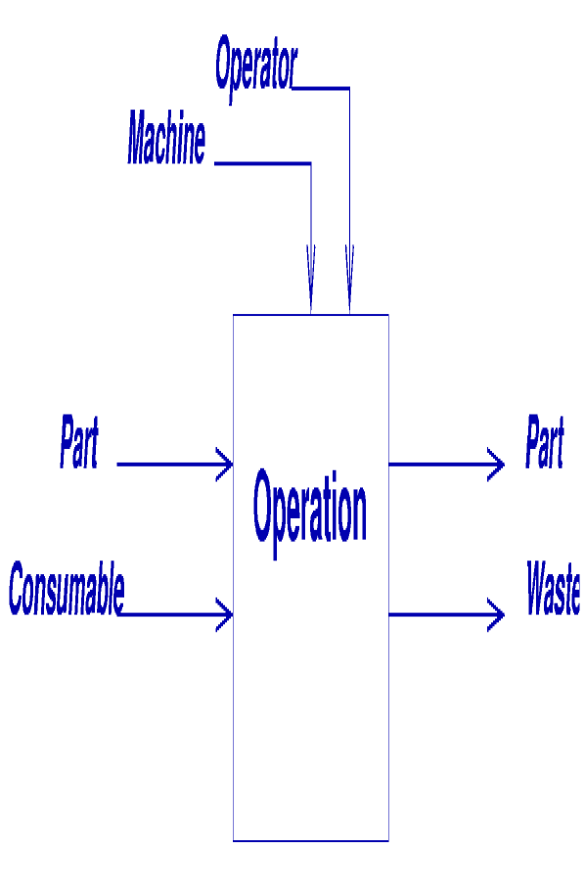
Concepts: Operation
Nothing happens unless Everything is present

Slide 19
Concepts: Waiting
Whatever does not arrive, something or someone has to wait:
Inventory: parts waiting
Under-utilization: Machines waiting
Idle work force: Operators waiting

Slide 20
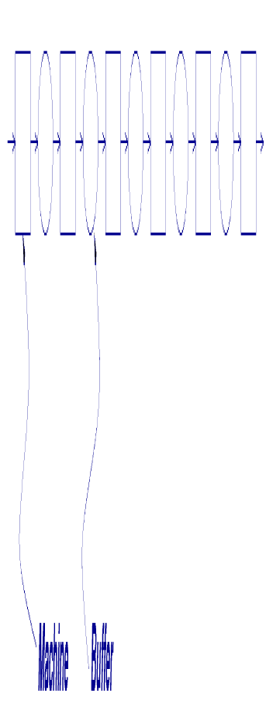
Kinds of Systems: Flow Shop
Sometimes referred to as: Flow Line, Transfer Line or Production Line.
Traditionally used for high volume, low variability production.

Slide 21
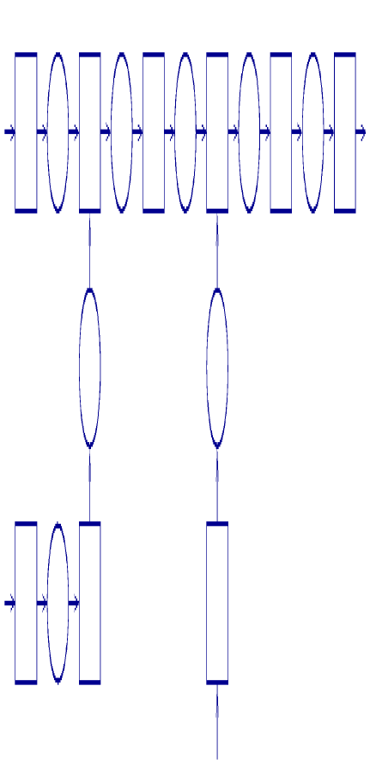
Kinds of Systems: Assembly System
Assembly Systems are trees, and may involve thousands of parts.

Slide 22
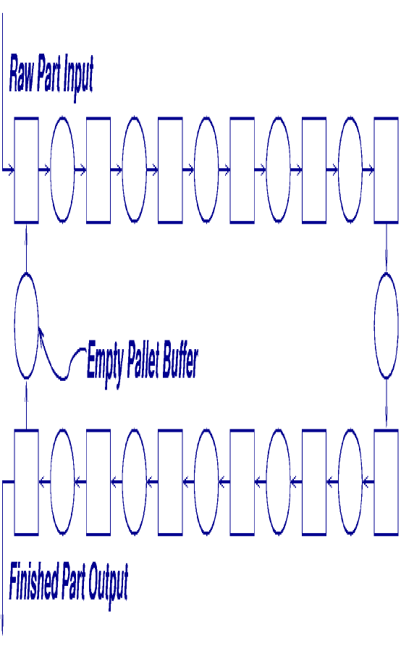
Kinds of Systems: Closed Loop
Limited number of pallets or fixtures.
Pallets or fixtures travel in a closed loop.

Slide 23
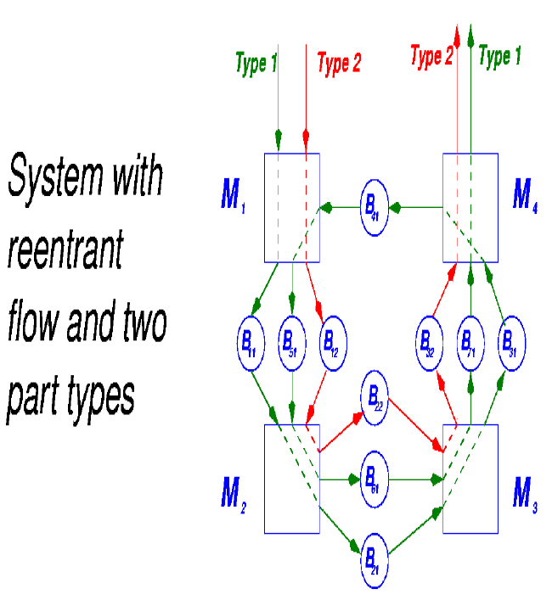
Kinds of Systems: Reentrant
Very common in semiconductor fabrication

Slide 24
Kinds of Systems: Job Shop
Machines not organized according to process flow
Often, machines grouped by department.
Mill department.
Lathe department.
…
Great variety of products.
Different products follow different paths.
Complex management.

Slide 25
Two Issues
Efficient Design of Systems
Efficient operation of systems after they are built.

Slide 26
Time
All factory performance measures are about time.
Production Rate: How much is made in a given time.
Lead Time: How much time before delivery.
Cycle Time: How much time a part spends in the factory.
Delivery Reliability: How often a factory delivers on time.
Capital pay-back Period: the time until the company gets its investment back.

Slide 27
Time
Time appears in two forms:
Delay
Capacity Utilization
Every action has impact on both

Slide 28
Time -Delay
An operation that takes 10 minutes, adds 10 minutes to the Delay that
A work piece experiences while undergoing that operation
Every other work piece experiences that is waiting while the first is being processed

Slide 29
Time – Capacity Utilization
An operation that takes 10 minutes, takes up 10 minutes of the available time of
A machine
An operator
Or other resources
Since there is a limited number of minutes of each available resource, there are a limited number of operations that can be done.

Slide 30
Time – Production Rate
Operation time: time that a machine takes to perform an operation
Production Rate: the average number of parts that is produced in a time unit. (also called throughput)
If nothing interesting ever happens (failure, etc…),
Production rate = 1/operation time
But something interesting always happens

Slide 31
Time - Capacity
Capacity: the maximum possible production rate of a manufacturing system, for systems that are making only one part type.
Short Term Capacity: determined by the resources available right now.
Long Term Capacity: Determined by the average resource availability.
Capacity is harder to define for systems making more than one part type. Since it is hard to define, it is very hard to calculate.

Slide 32
Randomness, Variability, Uncertainty
Factories are full of random events
Machine Failures
Change in orders
Quality Failures
Human Variability
The economic environment is uncertain
Demand variations
Supplier unreliability
Changes in costs and prices

Slide 33
Randomness, Variability, Uncertainty
Therefore,
Factories should be designed as reliably as possible, to avoid creating variability;
Factories should be designed with shock absorbers, to reduce the propagation of variability
Factories must be operated in a way that minimizes the creation of variability;
Factories must be operated in a way that minimizes the propagation of variability

Slide 34
Randomness, Variability, Uncertainty
Thus:
All engineers should know probability
especially manufacturing systems engineers

Slide 35
References
Stanely Gershwin
OCW.MIT.edu

